Slide 1
PARIS
Districts

Slide 2
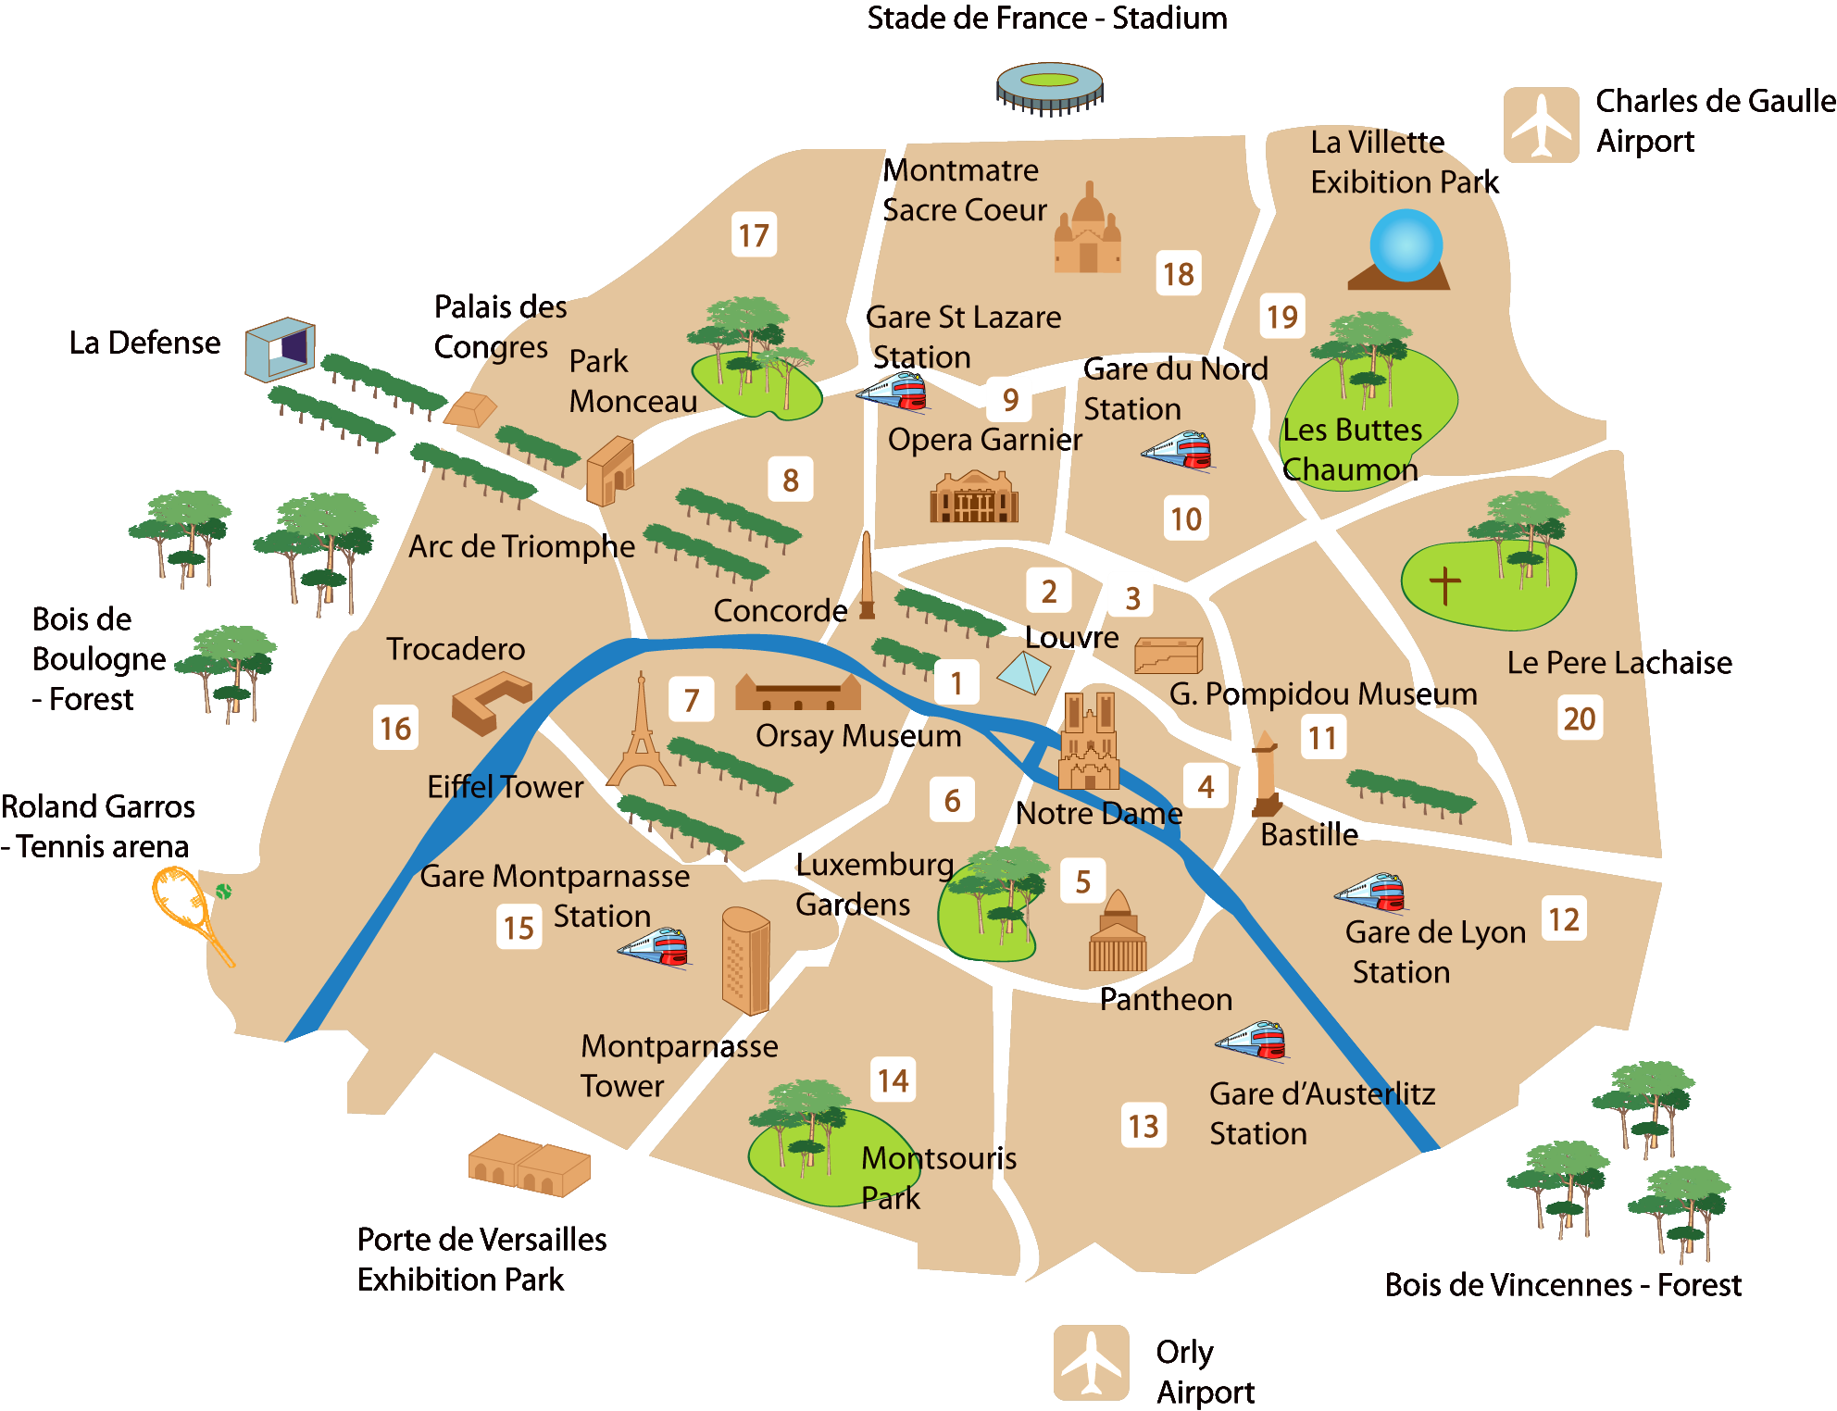
Data
The Data was obtained from different sources:
Wikipedia: In Wikipedia I obtained the name of the different districts in Paris.
Geocoder: With the geocoder library in Python I was able to convert the names of the districts to coordinates with latitude and longitude values.
With the Foursquare API I obtained all the information I needed from the venues in each district.

Slide 3
Methodology
The Methodology used whas Kmeans Clustering to segment the different districts taking into account the type of venues each one has.

Slide 4
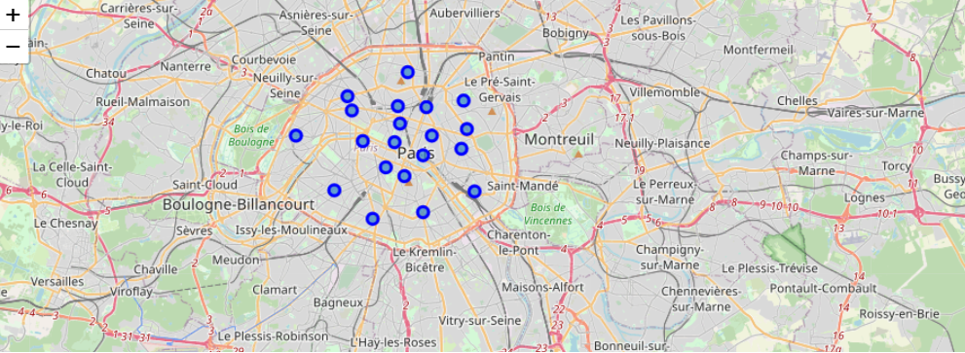

Slide 5
Results
Cluster 1
Cluster 0
Cluster 3
Cluster 4
Cluster 2
For toursists looking for an area where they can get some cheap food instead of only fancy restaurants
Drinks and party
Typical touristic cluster
in which there are
several hotels and french
restaurants.
French Restaurants and Fast Food
Supplies and hotels.

Slide 6
Results
Cluster 2 is the most appropiate for opening a Bar in Paris

Slide 7
Thank you

